Slide 1

MEDIA & THE PUBLIC
Week 4 (Mass) Media influence
Ryan Wang
ryanyang@psu.edu

Slide 2
Strong/Powerful media effect
McQuail’s four phrases model (2005)
WWI - 1930s
1930s – 1960s
Selective exposure
Magic Bullet
Hypodermic Needle
1960s – 1970s
Two-step flow
1970s -
Spiral of silence
Cultivation
Social constructivism
Framing
Agenda setting
Limited media effect
Revisit of strong media effect
Negotiated/transactional media effect

Slide 3
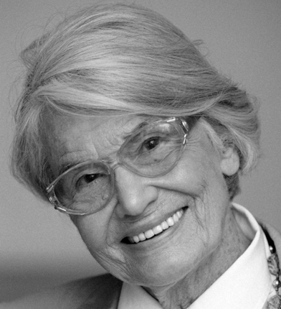
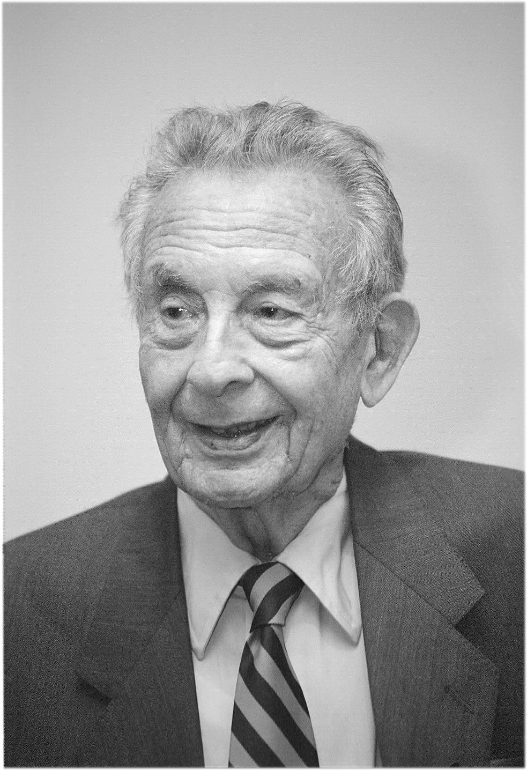

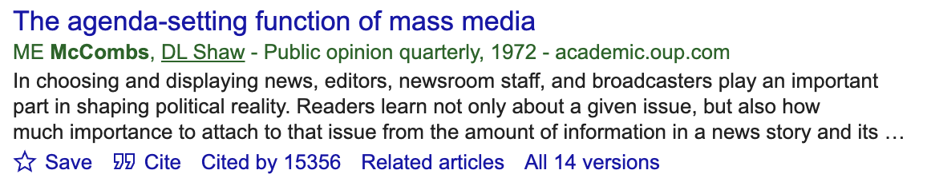
Paradigm shift: Revisit of strong media effect
Elisabeth Noelle-Neumann
(Spiral of Silence)
George Gerbner
(Cultivation;
the mean world syndrome)
David Shaw & Maxwell McCombs
(Agenda setting)

Slide 4
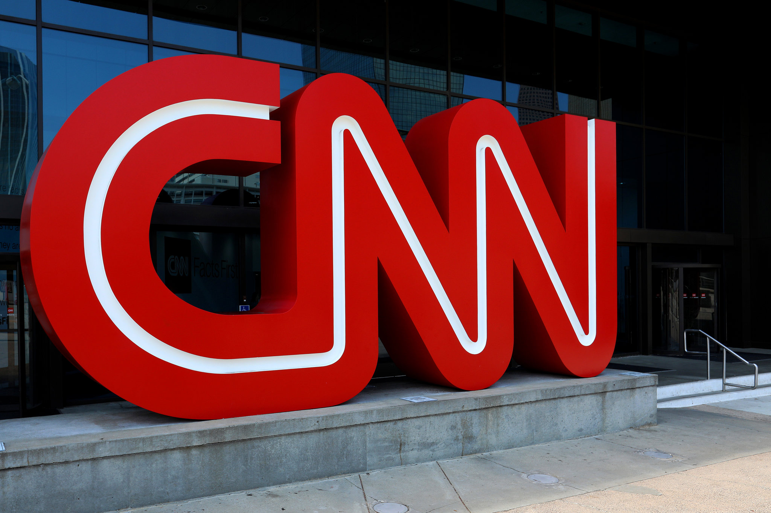
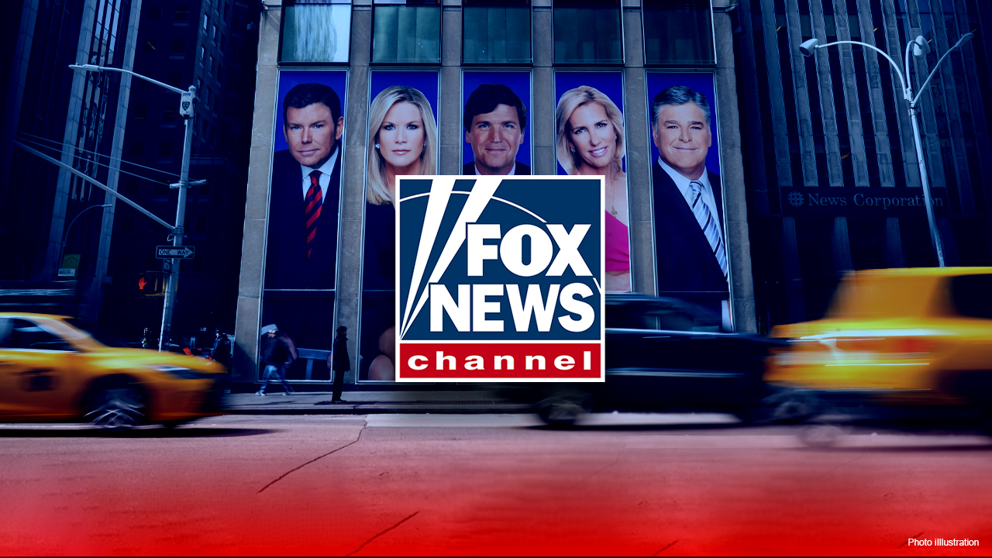
What is agenda setting?

Slide 5
Agenda setting (McCombs & Shaw, 1972)
Agenda setting refers to the ability of the mass media to signal to the public what is important
By virtue of providing differential levels of coverage to specific issues, the media are able to shape individuals’ perceptions of the relative importance and salience of these issues
Reality
selection, omission & framing
Agenda
Perceived reality

Slide 6
Agenda setting
Newspaper: Chapel Hill, North Carolina (McCombs & Shaw, 1972)
“Regardless of what politicians say, what are the two or three main things which you think the government should concentrate on doing something about?”
A strong rank-order correlation between citizens’ main concerns and the political issues covered by the plurality of news sources in Chapel Hill, which included local newspapers, the New York Times, and evening news broadcasts.
Television: (Iyengar & Kinder, 1987)
Whether the issues that received prominent attention on the national news became the ones that the viewing public saw as the nation’s most important problems (e.g., defense, pollution, unemployment, civil rights)
Online news: (Althaus & Tewksbury, 2002)
Readers of the print version of the New York Times, after five days, systemically differed from online readers of the same newspaper in what they perceived to be the most important problems facing the country

Slide 7
Moderators of agenda setting
Topicality: Unobtrusiveness
Agenda-setting effects are usually stronger for issues that are unobtrusive, or for those issues with which individuals have little or no direct experience ((Iyengar & Kinder, 1987)
Individual: Needs for orientation
In general, the greater an individual’s need for orientation, the more likely his or her perception of the issue agenda will reflect the media’s agenda (Weaver, 1977)
Interaction: Frequency of discussion
When both the media and interpersonal communication resonate, interpersonal communication about an issue can enhance agenda-setting effects

Slide 8
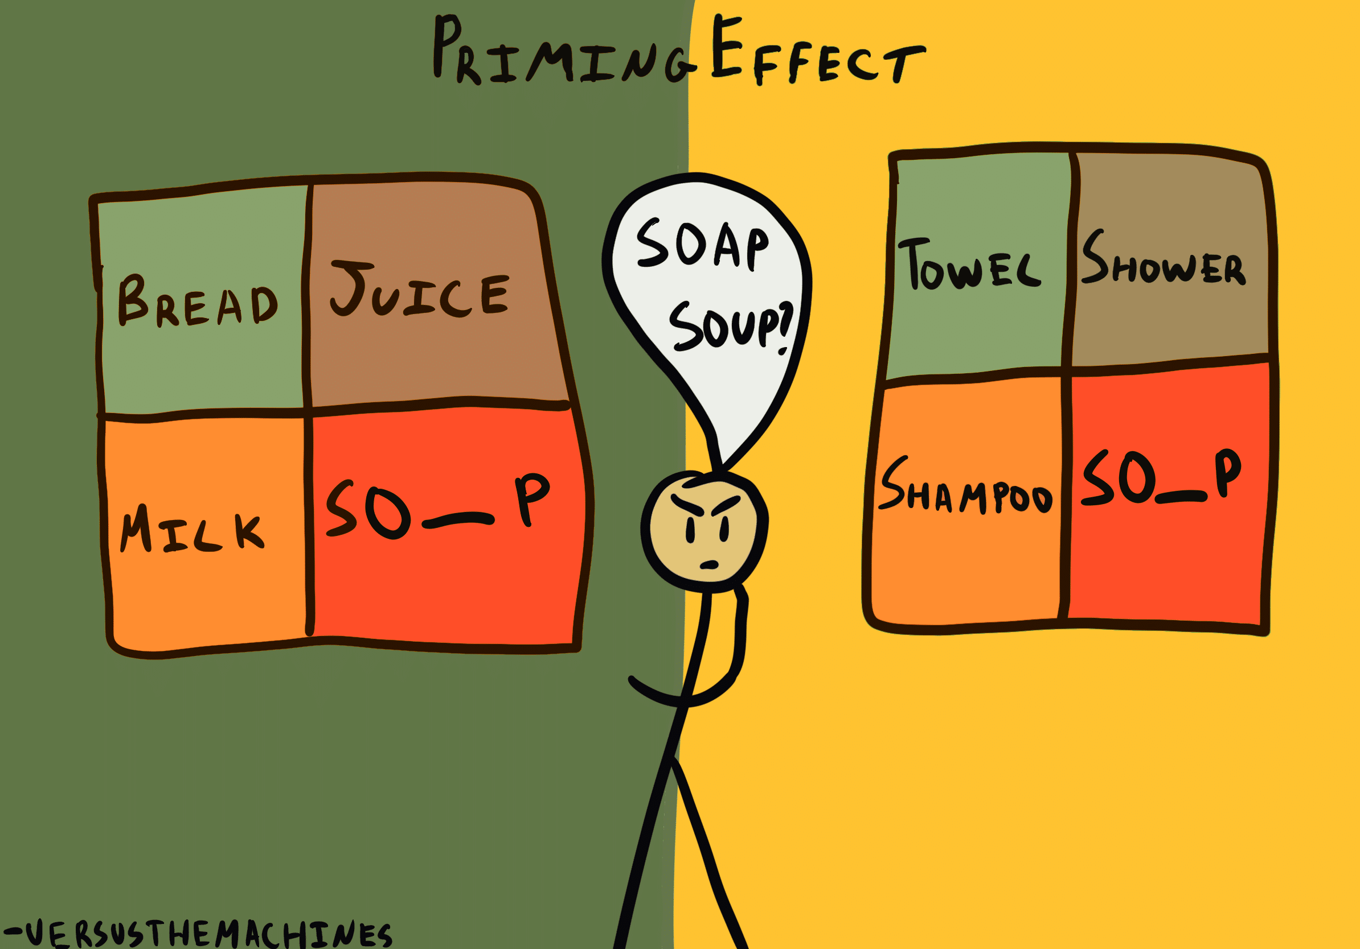
What is priming (effect)?

Slide 9
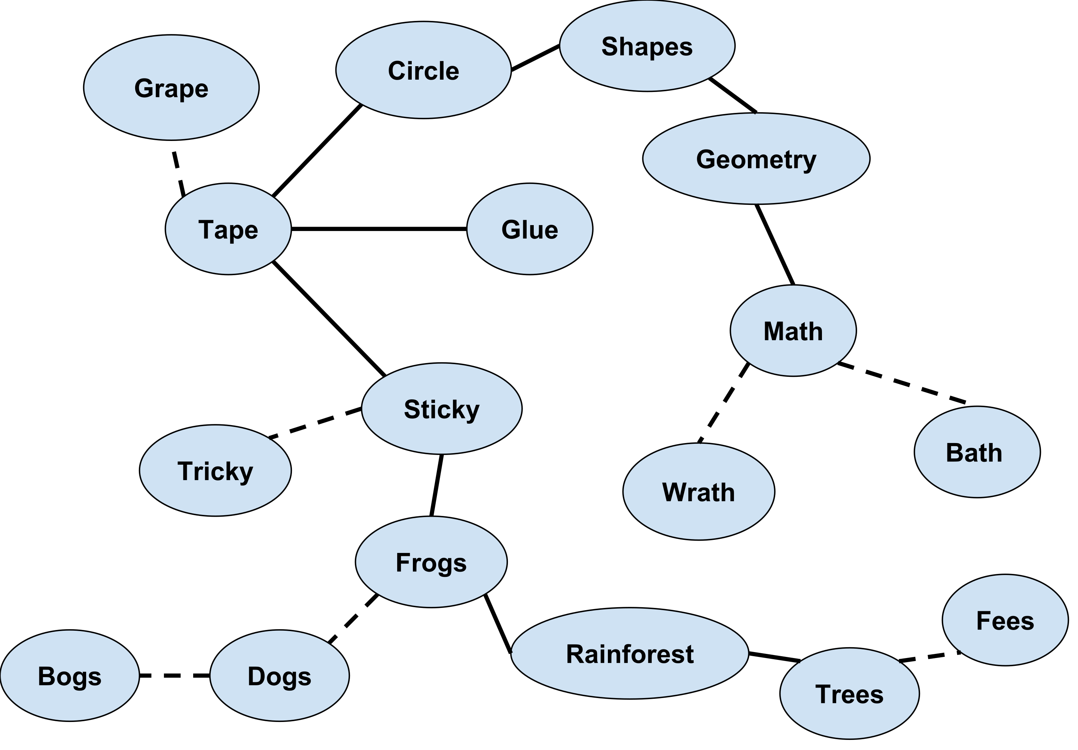
Psychological network model of memory
Dotted lines indicate morpheme primes
Straight lines indicate semantic primes

Slide 10
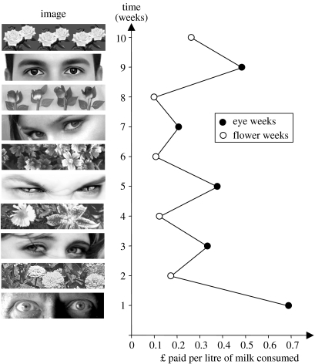
Source: Bateson et al. (2006)

Slide 11
(Media) Priming (Iyengar & Kinder, 1987)
(Media) Priming explains how media uses this psychological characteristic for influencing people without even letting them know and affect their decisions
Information received through a media channel (i.e., the “media prime”) activates preexisting associated knowledge in the mind of the receiver
The receiver applies the primed, now more accessible concept to a target stimulus when s/he would not otherwise have done this.
Iyengar, Peters and Kinder (1982)
Making certain political topics salient through prime-time media, such as defense or spending, would could viewers to evaluate President Carter based on said topics.

Slide 12
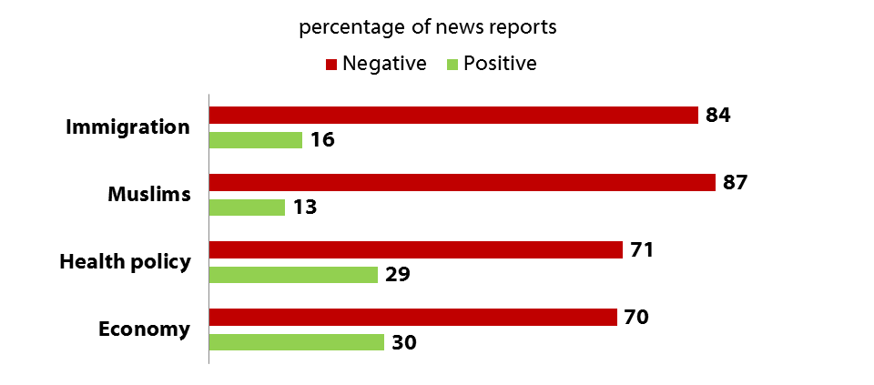
(Media) Priming (Iyengar & Kinder, 1987)
Tone of Coverage of Selected Topics, 2010-2016
Source: Media Tenor. Based on news reports on CBS and NBC evening newscasts. Excludes neutral stories.
Notes:
Agenda-setting out the topics; negative tones, this is something dangerous?

Slide 13
(Media) Priming (Iyengar & Kinder, 1987)
Connection with Agenda setting:
Both are grounded in mnemonic models of information-processing
Priming is seen as an outgrowth of the media effects process initiated by agenda-setting (Brosius, 1994)
Agenda-setting: Media make some issues more salient in people’s minds
Priming: media can shape the considerations that people take into account when making judgments about political candidates or other issues
Other moderators:
Political involvement
Cognitive style
Political attitude
etc.

Slide 14
What is framing?

Slide 15
(Media) Framing (Goffman, 1974; Entman, 1993)
Framing suggests that how something is presented to the audience influences the choices people make about how to process that information.
A frame is a concept that summarizes the basic characteristics of a topic, which could be a phrase, image, analogy, or metaphor
“To frame is to select some aspects of a perceived reality and make them more salient in a communicating text, in such a way as to promote a particular problem definition, causal interpretation, moral evaluation, and/or treatment recommendation for the item described.” (Entman, 1993)
Framing process (Scheufele, 1999)
Frame-building refers to the development of frames and their inclusion in news stories.
Frame-setting describes audience consumption of news with frames and audience members’ consequent adoption of frames as ways to understand issues and problems

Slide 16
(Media) Framing (Goffman, 1974; Entman, 1993)
Comparison with Priming:
Priming focuses on what information is presented (audience)
Framing focuses on how information is presented (content provider)
These elements overlap in actual communication practices, which is still under debate

Slide 17
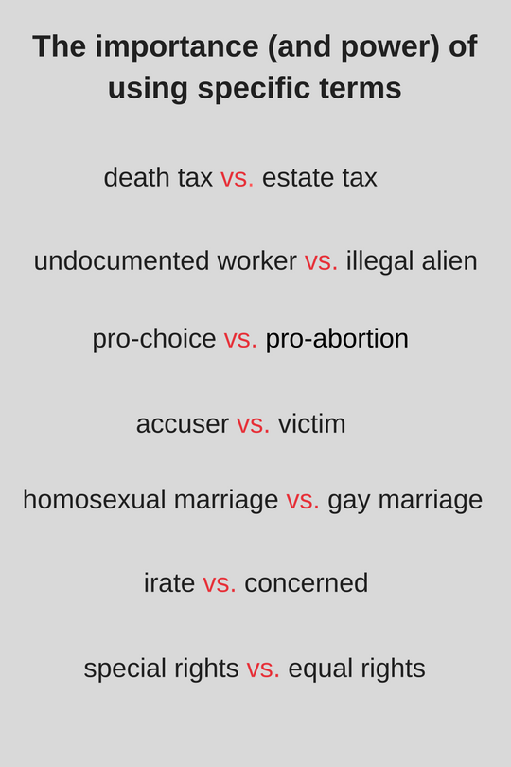
Notes:
Certainly this is an extreme example, demonstrating very specific perspectives, but it helps convey the power a story has in reporting the news. If we limit our news media consumption to few or even one media source, then, the frames used to report on that event or topic imply a very specific perspective of reality.

Slide 18
“A local citizen advocating for ‘illegal aliens’ was ‘irate’ at city hall Tuesday, demanding ‘special rights.’“
“A local citizen advocating for ‘undocumented workers’ was at city hall Tuesday ‘voicing concern’ over the lack of ‘equal rights.’”

Slide 19
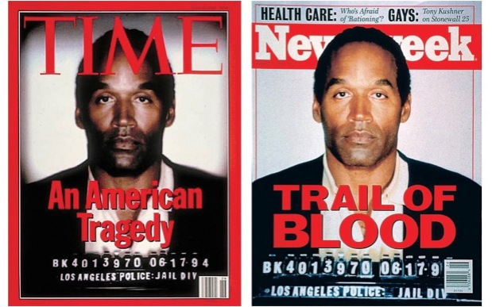
Source:
Time Magazine’s response

